Slide 1


AI-POWERED IMAGE CAPTIONING FOR INCLUSIVITY

Slide 2
INTRODUCTION
In the realm of visual recognition and language processing, our exploration of Image Captioning delves into the intersection of natural language processing and computer vision. Utilizing CNN and LSTM models, we navigate the encoder-decoder architecture to generate meaningful captions from visual input. This research aims to shed light on the potential applications of image captioning, from aiding the visually impaired through real-time text-to-speech to enhancing social media engagement. The versatility of image captioning extends to areas like biology, business, and even self-driving cars, promising a deeper understanding of deep learning methodologies.

Slide 3
WORKING EXPLANATION
1. A user uploads an image that they want to generate a caption for.
2. A gray-scale image is processed through CNN to identify the objects.
3. A gray-scale image is processed through CNN to identify the objects.
4. CNN scans images left-right, and top-bottom, and extracts important image features.
5. By applying various layers like Convolutional, Pooling, Fully Connected, and thus using activation function, we successfully extracted features of every image.
6. It is then converted to LSTM.
7. Using the LSTM layer, we try to predict what the next word could be.
8. Then the application proceeds to generate a sentence describing the image

Slide 4

OVERVIEW OF CNN
Convolutional Neural Network (CNN) is a specialized deep learning model designed for grid-patterned data, particularly images.
In the deep-learning CNN model, input images undergo convolution layers, pooling, fully connected layers (FC), and a Softmax function for probabilistic object classification.
CNNs feature distinctive convolutional layers, setting them apart from other neural networks like RNNs.
The input within a convolutional layer undergoes transformation using filters, distinguishing CNNs in data processing.

Slide 5

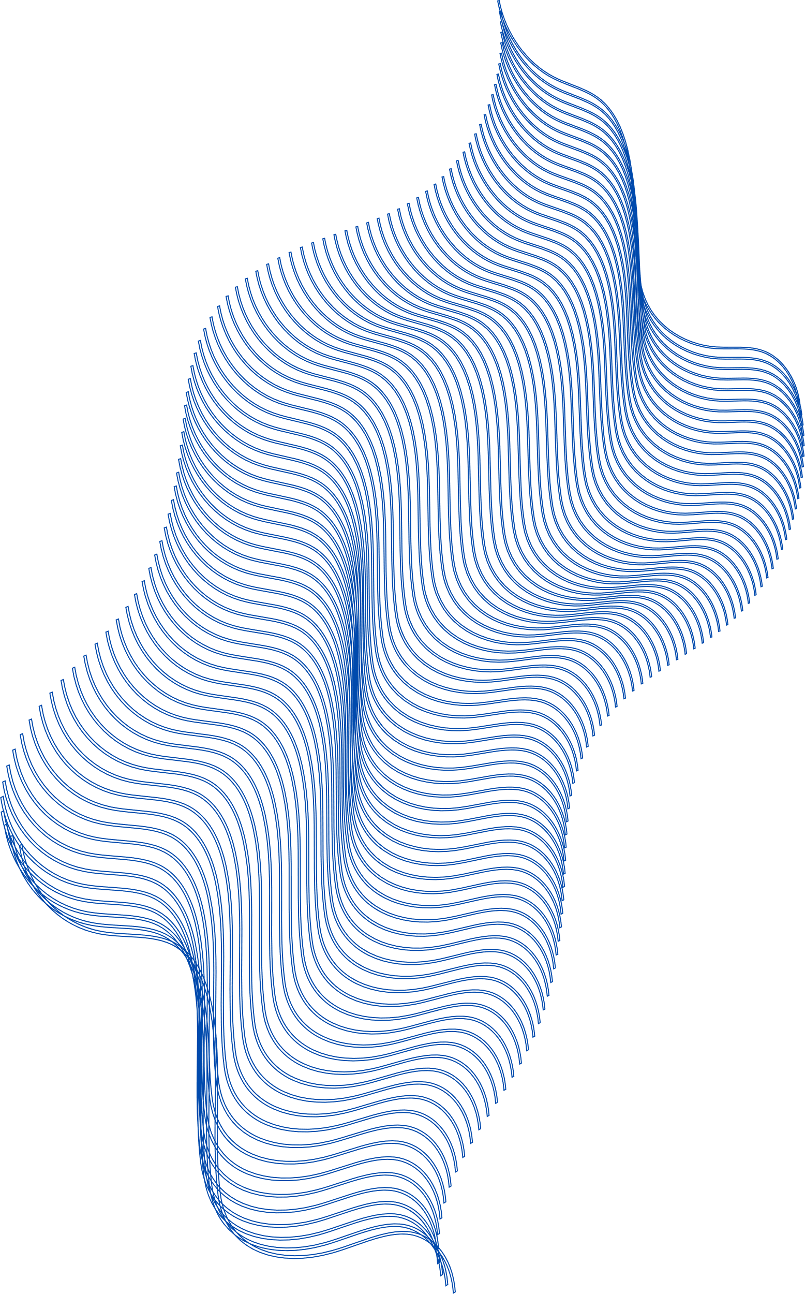
ADVANTAGES OF CNN
Suitable for both supervised and unsupervised learning.
Easily understandable and quick to implement.
Exhibits superior accuracy in image prediction compared to other algorithms.
Minimizes dependence on pre-processing, reducing the need for extensive human intervention in developing functionalities.

Slide 6
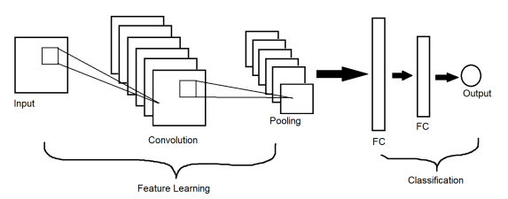
CNN

Slide 7
OVERVIEW OF LSTM
LSTM networks, a subtype of recurrent neural networks, excel in learning order dependence for sequence prediction tasks, vital in domains like machine translation and speech recognition.
LSTMs address the complexities inherent in challenging problem domains, showcasing their utility in areas such as machine translation and speech recognition.

Slide 8
ADVANTAGES OF LSTM
Offers a broad array of parameters, including learning rates, input, and output biases.
Significantly reduces the complexity of updating each weight to O(1) in LSTMs.

Slide 9
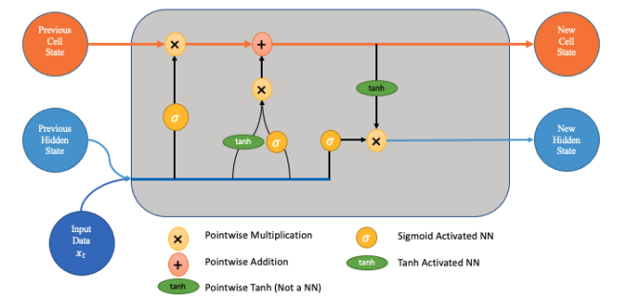
LSTM

Slide 10
CNN - LSTM ARCHITECTURE MODEL
The CNN LSTM model combines Convolutional Neural Network (CNN) layers for feature extraction with Long Short-Term Memory (LSTM) layers for sequence prediction.
Developed for visual time series prediction, this architecture excels in generating textual descriptions from sequences of images, including:
Activity Recognition: Describing activities demonstrated in a sequence of images.
Image Description: Generating textual descriptions for single images.
Video Description: Creating textual descriptions for sequences of images.
Originally known as Long-term Recurrent Convolutional Network (LRCN), it is referred to here as "CNN LSTM."
Utilizes a pre-trained Xception model for CNN feature extraction, with LSTM leveraging this information to generate image descriptions.

Slide 11
METHODOLOGY (ABRIDGED)
Import Libraries
Upload COCO Dataset 2017 (Data Preprocessing)
Apply CNN for object identification
Preprocess and tokenize captions
Use LSTM for predicting the next word in a sentence
Implement Data Generator
View Images with Captions

Slide 12
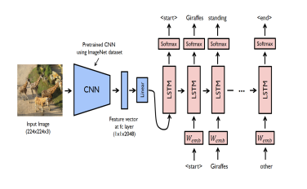
SYSTEM ARCHITECTURE

Slide 13
CONCLUSION
The CNN-LSTM model was created to automatically generate captions for the input images. This concept can be used in a wide range of situations. We learned about the CNN model, and LSTM models, and how to overcome previous limitations in the field of graphical image captioning by building a CNN-LSTM model capable of scanning and extracting information from any input image and transforming it into a single line sentence in natural language English. The algorithm attention and how the attention mechanism is used were the main topics of discussion. I was able to successfully create a model that is a major improvement above the earlier image caption generator.

Slide 14
THANK
YOU!

